Slide 1


ITM 440/540 Data Networks
Network Terms and Models
Professor: Carol Davids
Email: davids@iit.edu

Slide 2
Reading Assignment
Forouzan : Chapter 1 - Introduction
Forouzan : Chapter 2 - Network Models

Slide 3
Homework
Homework 1 - posted to to blackboard - due before class next Tuesday

Slide 4
Data Networking
The art, technology and science that enables processes in remote computing devices to communicate with each other.

Slide 5
We are concerned with
Characteristics of the data
Characteristics of the network
Physical architecture of the network
Logical architecture of the network
Characteristics of the processes that run on the network nodes
Protocols that the processes use to communicate with each other across the network

Slide 6
Network
Set of two or more nodes (devices or functions) connected to communications links.
A network is a connected set of nodes and links.

Slide 7
Direction of Data Flow
Simplex - transmission is one direction only
Half-Duplex - both stations can transmit - but not at the same time
Full-Duplex - both stations can transmit at the same time

Slide 8
Type of connections
Point to Point
Provides a dedicated link between two devices
The entire capacity of the link is reserved for transmission between the two devices

Slide 9
Type of connections
Multipoint
More than two devices share a single link
The capacity of the link is divided up in some way
The capacity can be shared physically
The capacity can be shared in time

Slide 10
Topology
Topology is the arrangement of network nodes and links.
Network topologies include:
  Mesh
  Star
  Bus
  Tree
  Ring

Slide 11
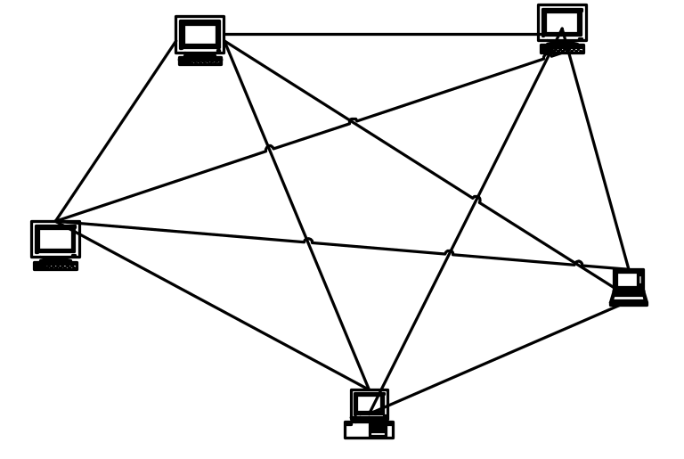
Mesh Topology
Every device has a point to point link to every other device (that is, the link carries traffic only between those two devices.)

Slide 12
Mesh Topology*
If there are 4 devices, there need to be 4x3/2 = 6 physical channels and 3 I/O ports per device.
If there are 5 devices, there need to be 5x4/2 = 10 physical channels and 4 I/O ports per device
If there are 6 devices, there need to be 6x5/2 = 15 physical cannels and 5 I/O ports per device.
This solution does not scale well!

Slide 13
Advantages of the Mesh Topology
No Contention: If two devices need to communicate, no other device will prevent them.
Robust: If one link goes down it does not affect the ability of other devices to communicate.
Secure: When messages travel on dedicated links, no one can snoop on them.
Fault resolution is easy: If you lose communication between 2 devices you know what path the traffic is taking and can act to fix it quickly.

Slide 14
Disadvantages of the Mesh Topology
Too many cables are needed.
Too many ports are needed.

Slide 15
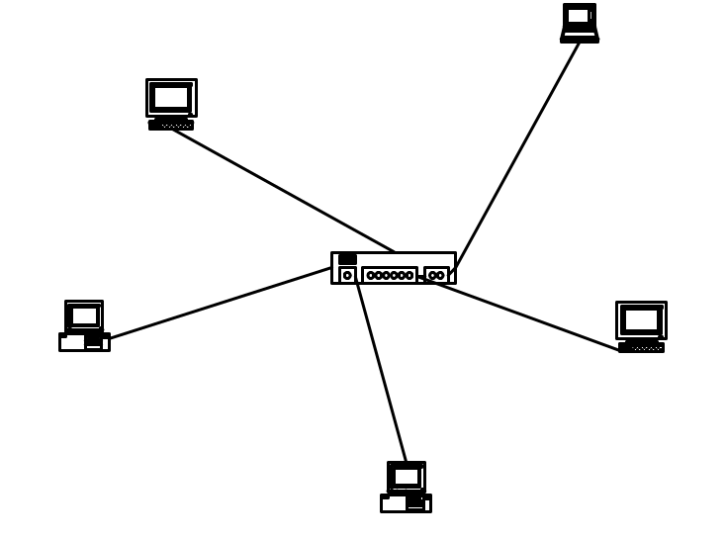
Star Topology
Each device has a dedicated point-to-point link only to a central controller.

Slide 16
Star Topology
Note that the end devices are not connected to each other.
End devices are connected to a centralized node or switching system.
Traffic between end devices must pass through the central node or switching system.
Each device needs only one link and one port to communicate with any of the other devices.

Slide 17
Star Topology
If there are 4 devices, there need to be 4 links and a hub.
If there are 5 devices, there need to be 5 links and a hub.
If there are 6 devices, there need to be 6 links and a hub.
This scales better than the mesh.
But you need a new device - the hub, node, switching system - that serves as the communications link between any of the devices.

Slide 18
Advantage of the Star Topology
Lower cost: Since less links means less cost for cables than for the mesh.
Robust: If one link fails, only the device connected to it is affected.
Easy Fault identification: The hub/ node/switching system can monitor its ports.

Slide 19
Disadvantage of the Star Topology
The hub/node/switching system is a single point of failure.
If it fails, there is no communication between any device on the network.

Slide 20
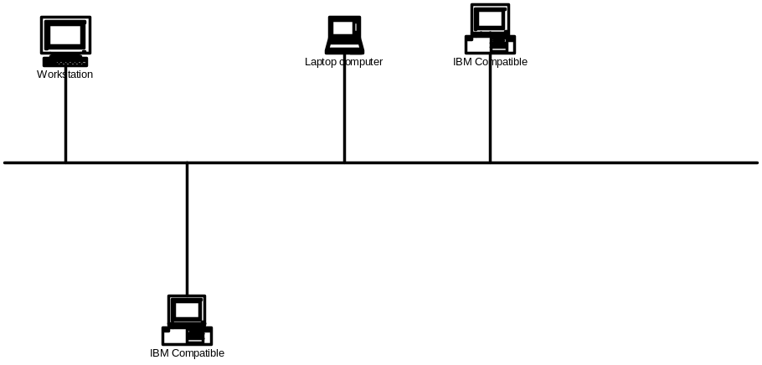
Bus Topology
Bus topology is multipoint.
A single cable acts as a backbone that links all the devices on the network.

Slide 21
Bus Topology
Devices are connected to the backbone by means of drop lines and taps.
The tap is the actual connector that splices or otherwise physically makes contact with the backbone.
The drop line connects the tap to the device.

Slide 22
Bus Topology
Both ends of the backbone cable must be terminated to prevent reflections.
As signals travel down the backbone they attenuate (weaken).

Slide 23
Advantages of the Bus Topology
Fewer feet of cables used than for mesh or star.

Slide 24
Disadvantages of the Bus Topology
Difficult to move devices or to add new devices.
Reflections and attenuation degrade the signals, and this gets worse as you add and remove devices.
Hard to isolate trouble. Which piece of the backbone is bad? Which tap is bad? Trouble anywhere on the backbone or a tap may be reflected in different parts of the network.

Slide 25
Tree Topology
A form of the Bus Topology
Includes a root or head-end
One or more cables start at head end
Buses branch off from this cable and from each other
There is no closed loop - only one way to get to each device on the tree

Slide 26
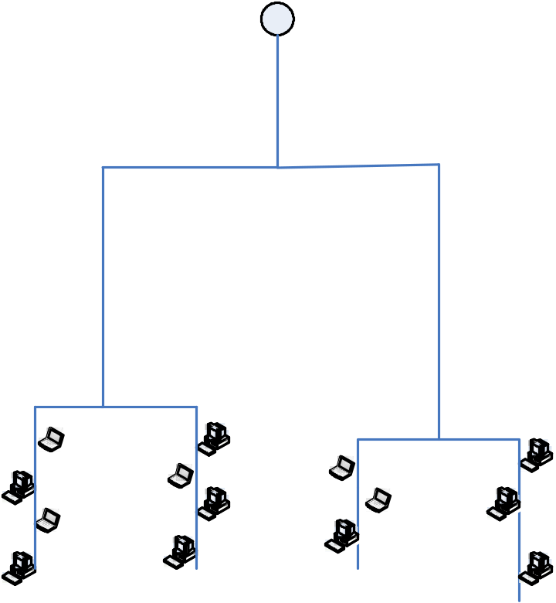
Tree Topology
Cascade of buses
Example is cable TV network

Slide 27
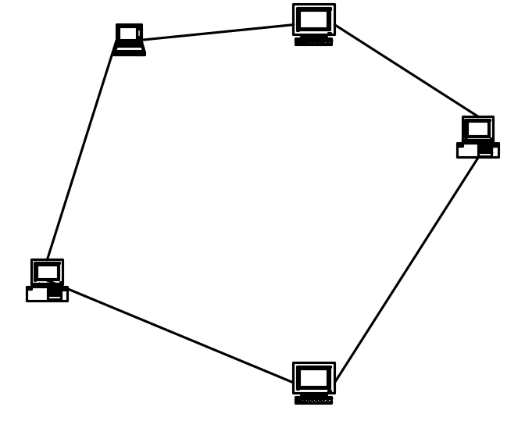
Ring Topology
Each device has a dedicated point to point link only to the two devices on either side of it.

Slide 28
Ring Topology
Data is passed around the ring in one direction from device to device until it reaches the destination device.
Each device in the ring reads the information in the header of the frame it receives. If the frame is not destined for that device, the device repeats the signal (recreates it) and sends it on around the ring to the next device.

Slide 29
Ring Topology
Notice that there are point to point links connecting the devices to each other, but now the traffic on the link between device A and device B may be destined for device C.

Slide 30
Advantages of a Ring Topology
Easy to install and reconfigure
Easy to isolate trouble, since if device A does not receive a signal after a specified period of time, it will issue an alarm.
Notice, that while we have not added a centralized device, like a hub, we have added some overhead management functions to the network.

Slide 31
Disadvantages of a Ring Topology
One-directional traffic creates a vulnerability.
If the link between device A and B breaks then all communication on the network ends.
Usually this is resolved by creating a redundant set of links over which the signal travels in the reverse direction.

Slide 32
Ring Topology
Devices are connected to one to another in a ring.
A data token is used to grant permission for each computer to communicate.

Slide 33
Categories of Networks
We now introduce three terms that are used to categorize networks:
LAN, MAN, WAN
These can be distinguished by their scope – how broad an area that cover
Depending upon their scope these three different categories use distinct datalinks
The term datalink will be defined soon – it refers to the roadbed over which your actual data will flow

Slide 34
Category of Networks
LAN - Local Area Network
  Usually privately owned
  Connects devices in a building or on a campus
  Size limited to a few kilometers

Slide 35
Category of Networks
MAN - Metropolitan Area Network
  Extends over a city
  Examples include Cable TV networks and the SMDS* public data network offered by some telephone companies
  (*Switched Multi-megabit Data Service)

Slide 36
Category of Networks
WAN - Wide Area Network
  Long-distance transmission of data, voice, video over large geographic areas
  SONET/SDH and MPLS are examples of protocols used on WANs
  WANs are used to connect LANs and MANs

Slide 37
Internets and The Internet
An internet is two or more networks than can communicate with each other.
The Internet is one example of an internet.

Slide 38

internet
Illustration, Figure 1.12 on page 16
Carol Davids @2014

Slide 39
The Internet
Made up of many WANs and LANs joined together by intermediate devices including routers and switches.
Internet Service Providers:
  International
  National
  Regional
  Local

Slide 40
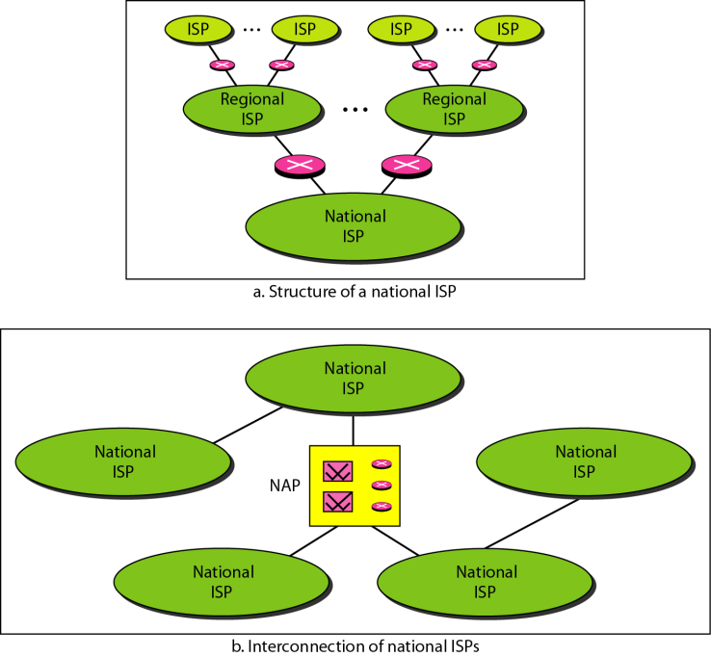
The Internet
Figure 1.13: hierarchical organization of the Internet
Carol Davids @2014

Slide 41
Protocols
Protocols are the languages that the processes use to communicate with each other.
They are the input and output messages that processes use to communicate with each other.

Slide 42
Standards
Open Standards allow computing devices and intermediate devices manufactured by different vendors to interoperate.
They provide a common language
Distinct from proprietary standards

Slide 43
Standards
IETF - http://www.ietf.org/
Internet Engineering Task Force
Creates the open standards for the Internet
Anyone can participate
Open meetings 3 times a year
You can subscribe to a mailing list

Slide 44
Standards
IEEE - http://www.ieee.org/portal/site
Institute of Electrical and Electronics Engineers
Creates layer 1 and layer 2 standards

Slide 45
Standards
ITU-T - http://www.itu.int/home/
International Telecommunications Union - Telecom
Members are governments and corporations

Slide 46
Standards
W3C
  http://www.w3.org/
  http://www.w3.org/standards/
Members are organizations, including enterprises such as Avaya, and Universities such as University of Bologna, and Government Agencies including Health and Human Services
Goal is to develop Web standards

Slide 47
university resource
Internet2
http://internet2.edu
http://www.planet-lab.org

Slide 48
Functions that data networks provide
Nodes create physical signals that represent the binary digits '1' and '0' and that can be imposed on the links
Links carry these physical signals to other nodes
A node or link may introduce errors into the signals that are sent. These errors may need to be detected and corrected.
Network addresses may be needed to identify the source node and the destination node
A route between the source node and the destination node may need to be identified.

Slide 49
Layered Protocols
These functions are provided by means of Layered Protocols.
Layering creates categories of data networking functions, and isolates the categories from each other
Higher layers of the protocol do not need to implement functions of the lower layers.

Slide 50
How Layers Work
The application process creates some data and hands it off to the data-networking process
Data-networking process gives the application layer data to its layer 4 process
The layer 4 process adds a header to the data. The header contains information that the layer 4 peer at the far end will need in order to properly handle the application data.
L4 header
Application Data

Slide 51
Encapsulation
L4 header
Application Data
After the layer 4 process adds its header, it hands the enlarged data packet to the layer 3 process.
This is an inter-layer hand-off and it has its own rules.
Now the layer 3 process adds its own header
L3 header
L4 header
Application Data

Slide 52
Encapsulation
L3 header
L4 header
Application Data
After the layer 3 process adds its header, it hands the enlarged data packet to the layer 2 process.
This is an inter-layer hand-off and it has its own rules.
Now the layer 2 process adds its own header
L2 header
L3 header
L4 header
Application Data

Slide 53
Encapsulation
L2 header
L3 header
L4 header
Application Data
After the layer 2 process adds its header, it hands the enlarged data packet to the layer 1 process.
This is an inter-layer hand-off and it has its own rules.
Now the layer 1 process operates on the bits it receives according to its protocol rules and creates SIGNALS on the network medium.

Slide 54
Encapsulation
L2 header
L3 header
L4 header
Application Data
The process we just described is called encapsulation.
Notice that as the application data is sent down the stack it picks up more and more bits – so the original data packet gets larger and larger.
By the time it arrives at the layer 1 process it has more bits than the original application data had.

Slide 55
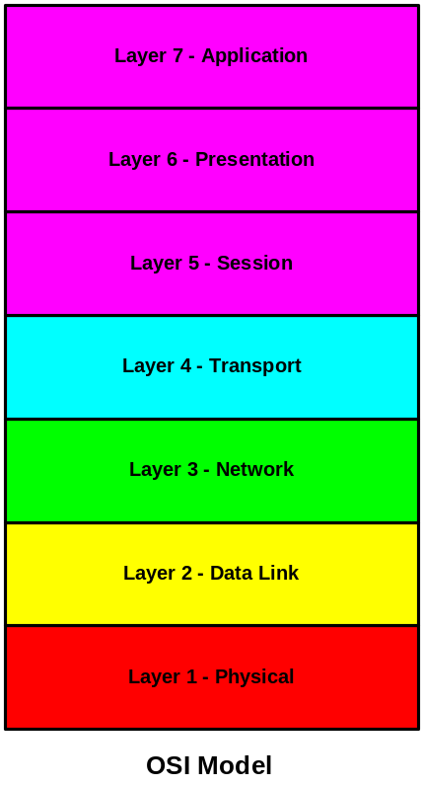
OSI Model
The International Organization for Standards (ISO) developed the Reference Model for Open Systems Interconnection in the late 1970’s.
The Reference model is referred to as the OSI 7-layer protocol stack gives us a way to logically separate the different communications functions that the network provides.

Slide 56
Layer 1 - Physical Layer - defines the physical characteristics of 1’s and 0’s, how to distinguish them from noise.
Layer 2 - Data Link Layer - defines how to put bits into frames and create an error-free connection between two devices on the same medium
Layer 3 - Network Layer - defines how to perform routing, congestion control, and create a logical network on top of the links created at layer 2.

Slide 57
Layer 4 - Transport Layer - Enables process-to-process communication between devices on remote networks.
Layer 5 - Session Layer - Controls the dialog between applications in the end-systems.
Layer 6 - Presentation Layer - Resolves differences in format and data presentation.
Layer 7 - Application Layer - Provides a user interface and supports distributed applications

Slide 58
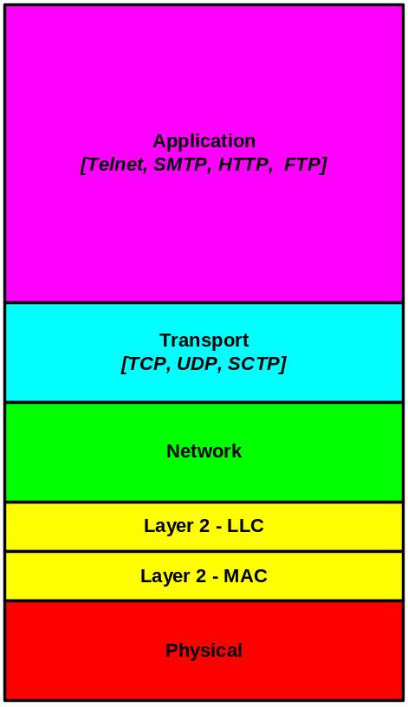
IP Model
Fewer Layers
More functionality per layer
Fewer headers
But more information per header

Slide 59
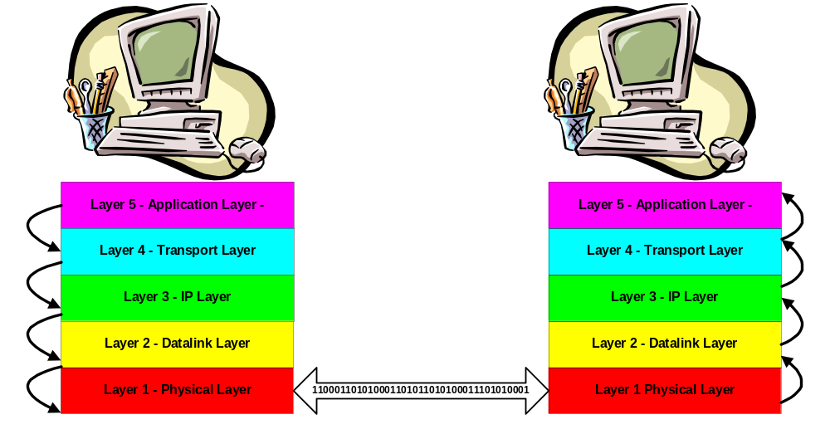
Layered communication
Applications appear to talk directly to each other.

Slide 60
Layer 1 - Physical Layer
Describes and defines the functions needed to transmit a bit stream over a physical medium.

Slide 61
Layer 1 - Physical character of Medium
What kind of a physical link is used?
  Unshielded Twisted Pair (UTP)
  Coaxial Cable
  Fiber Optic
  Wireless - radio waves
  Microwaves

Slide 62
Layer 1 - Physical character of Interfaces
What kind of a physical connector is used?
  RJ45 - 8 conductors - twisted pair
  BNC - T-Connection to coaxial cable
  SC (Subscriber Channel ) Connector - for connecting fiber to cable TV
  ST (Straight Tip) Connector - for connecting fiber to network devices

Slide 63
Layer 1 - Representation of Bits
Coding and modulation schemes that are used to represent the 1s and 0s that make up the data

Slide 64
Layer 1 - Physical Layer
How do we physically represent a logical ‘1’?
How do we physically represent a logical ‘0’?
  Can use pulses of electrical energy
  Can use variations in an electromagnetic wave

Slide 65
Layer 1 - Data Rate
The number of bits per second

Slide 66
Layer 1 - Synchronization
Synchronization of bits - allows the receiver to coordinate with the sender
  For example: when the sender sends bit number 4,528 the receiver has “synched up” its clock with the sender’s and knows that this is the 4,528th bit.
  If the sender and receiver are not synched up then receiver cannot interpret the data correctly

Slide 67
Layer 2 - Data Link Layer
Hides the physical layer from the network layer
Defines groups of bits - frames - within the raw bit stream created at layer 1
These groups of bits can then be associated with meaning beyond a simple 0 or 1

Slide 68
Layer 2 - Data Link Layer
Examples of data link layer protocols
  Ethernet
  IEEE 802 for LANs
  Q.921
  HDLC
  LAPB
  LAPD
  DOCSIS MAC layer for cable networks

Slide 69
Layer 2 - Functions
Framing
Physical Addressing
Flow control
Error Control
Access Control

Slide 70
Layer 2 - Framing
Layer 2 divides the raw bit stream created at layer 1 into groups of bits called frames.

Slide 71
Layer 2 - Physical Addressing
Identifies the device on the link
Enables device connected to the link to select only the frames destined for it
Enables device connected to the link to identify the intended recipient of the frame it is sending

Slide 72
Layer 2 - Physical Addressing
If the frame is being sent to a distant LAN, there will be some interworking device (translation function) between the two LANs
That Interworking device (translation function) will have a layer 2 address (physical address)
It is the layer 2 address of the Interworking device (translation function) that the frames will be sent to

Slide 73
Layer 2 - Flow Control
Flow control is a function that allows you to regulate the rate at which the sender sends data
This prevents the receive buffers from overflowing - an event which results in loss of data
Not all data link protocols employ flow control functions

Slide 74
Layer 2 - Error Control
Error control is a function that can include both error detection and error correction
Error control mechanisms can enable the next higher layer to assume error-free transmission over the link

Slide 75
Layer 2 - Error Detection
The error detection at layer 2 is usually done something like this:
  The sending device performs a calculation over the bits it is preparing to send and sends the results of the calculation to the receiver together with the frame.
  The receiver performs the same calculation and compares the results.

Slide 76
Layer 2 - Error Detection
If the results are the same, the receiver assumes that the bits it received are the same as the bits that were sent.

Slide 77
Layer 2 - Error Detection
But the error detection provided by the data link layer exists only between the two directly-connected systems
If two systems are not directly connected the connections consist of a number of data links in tandem - each functioning independently
Then, higher layers are responsible for error control end-to-end.

Slide 78
Layer 2 - Access Control
Access Control defines which device can put signals onto the line at a given time

Slide 79
Layer 2 - Access Control - examples
  On a point to point full duplex link, the two devices are free to send at any time
  On a multipoint link, such as a bus, two devices might send at the same time - then their signals would collide - access control mechanisms are needed to handle such collisions

Slide 80
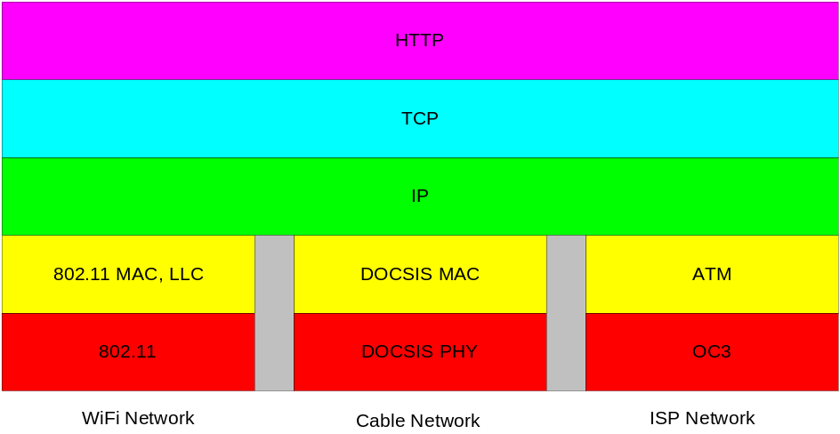
IP interconnects networks
“Sandwich Diagram” shows three different physical networks with different physical layers and data-link layers.

Slide 81
Layer 3 - Network Layer
Provides functions for routing traffic through a network from one node to the next
Regardless of what type of layer 2 (data-link) there may be between the source and the destination
Examples
  Internet Protocol (IP)
  Q.931 - a telephony protocol

Slide 82
Layer 3 - Network Layer functions
Logical Addressing
Routing

Slide 83
Layer 3 - Logical Address
Layer 3 provides network addresses
On the Internet, we are familiar with IP Addresses (layer 3 addresses)
The IP address of a device on the Rice Campus for example is 216.47.140.68.

Slide 84
Layer 3 - Routing
Routing function is concerned with sending a packet of data to a node that is either its final destination - or the “next hop” along a path to its final destination.

Slide 85
Layer 3 - Network Layer
Provides for the transfer of information between end systems across a communications network.
Relieves higher layers of the need to know anything about the underlying data transmission and switching technologies used to connect the systems.
The computer system has a dialog with the network to specify the destination address and to request certain network assistance such as priority.

Slide 86
Layer 3 - DTE and DCE
Communications across a network between processes in separate systems involves two kinds of entities
  Data Terminal Equipment
  Data Circuit terminating Equipment

Slide 87
Layer 3 - Data Terminal Equipment (DTE)
    End Systems
    Contain the application processes
    Implement all layers of the layered protocol
    Referred to as Data Terminal Equipment (DTE)

Slide 88
Layer 3 - Data Circuit terminating Equipment
    Nodes or Switching Systems
    Manage communication across the network
    Referred to as Data Circuit-terminating Equipment (DCE)
    Operate at Layer 3 and below

Slide 89
Layer 4 - Transport Layer
Provides a mechanism for exchanging data between processes in end-systems on different networks.
May provide for either reliable or unreliable transport.

Slide 90
Layer 4 - Transport Layer
Elements that go into reliable transport include:
  Data units are delivered error-free
  Data units are delivered in sequence
  Data units are not lost
  Data units are not duplicated
  A defined Quality of Service is maintained

Slide 91
Layer 4 - Transport Layer
Quality of Service metrics include:
  Acceptable error rate
  Maximum delay
  Prioritization of different types of data
  Security

Slide 92
Application Layer
Enables a human or process to gain remote access to the services on a remote computing device
  FTP - File Transfer Protocol
  SMTP - Simple Mail Transfer Protocol
  TELNET - Remote terminal capability
  HTTP -Web browsing

Slide 93
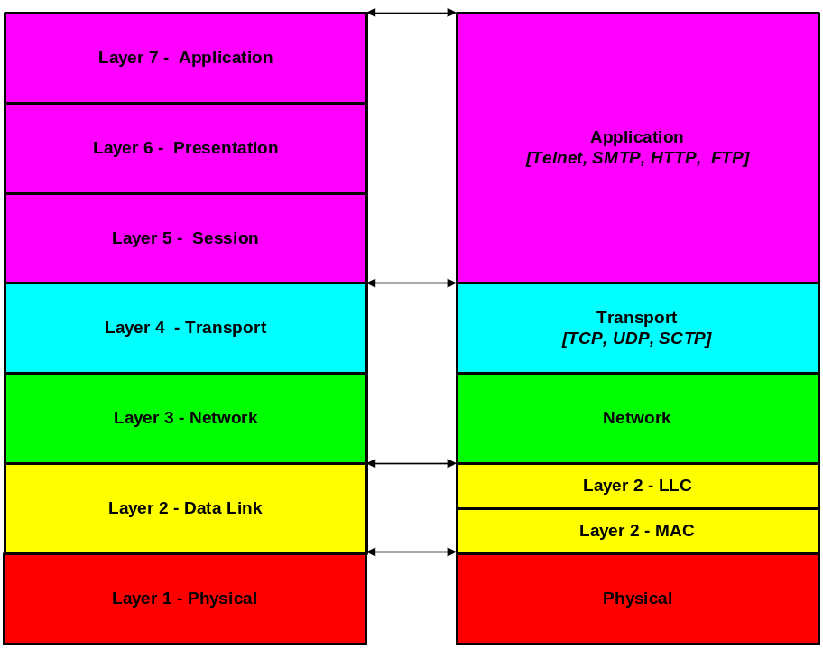
OSI Model vs. Internet Model

Slide 94
OSI Model vs. IP Model
IP model does not distinguish between the functions at layers 5, 6 and 7 of the OSI Model.
IP separates the functions at layer 2 into two distinct sub-layers - MAC and LLC

Slide 95
Encapsulation
When messages are sent across the network using a layered protocol, the higher layers are carried as the payload of the lower layers.
  The payload of a layer 2 message is a layer 3 message.
  The payload of a layer 3 message is a layer 4 message.

Slide 96
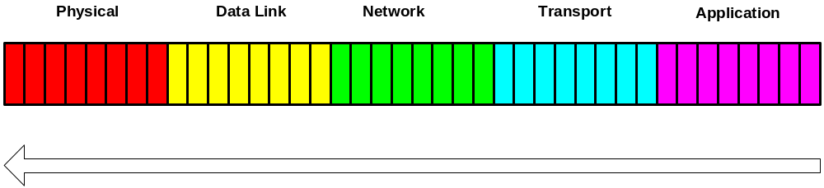
Encapsulation
All data on the network is encoded as 1’s and 0’s.
1’s and 0’s are collected into frames, packets, protocol data units - aggregates of one kind or another - since isolated 1’s and 0’s can provide very little information

Slide 97
Encapsulation
Bits representing the data link layer information are followed by bits representing the network layer, which are followed by bits representing the transport layer, and so on.

Slide 98
Example Protocol Trace
-Trace taken using Ethereal
-Layers 2 and 3 shown here
-Layers 4 and 5 on next page
Encapsulation
Frame 47 (353 bytes on wire, 353 bytes captured)
Ethernet II, Src: 00:0f:24:5d:97:70, Dst: ff:ff:ff:ff:ff:ff
Destination: ff:ff:ff:ff:ff:ff (Broadcast)
Source: 00:0f:24:5d:97:70 (192.168.123.4)
Type: IP (0x0800)
Internet Protocol, Src Addr: 0.0.0.0 (0.0.0.0), Dst Addr: 255.255.255.255 (255.255.255.255)
Version: 4
Header length: 20 bytes
Differentiated Services Field: 0x00 (DSCP 0x00: Default; ECN: 0x00)
Total Length: 339
Identification: 0x0004 (4)
Flags: 0x00
…..

Slide 99
Example Protocol Trace
-Trace taken using Ethereal
-Layers 4 and 5 of the example on previous page
User Datagram Protocol, Src Port: bootpc (68), Dst Port: bootps (67)
Source port: bootpc (68)
Destination port: bootps (67)
Length: 319
Checksum: 0x0000 (none)
Bootstrap Protocol
Message type: Boot Request (1)
Hardware type: Ethernet
Hardware address length: 6
Hops: 0
Transaction ID: 0x245d9770
Seconds elapsed: 0
…..
Encapsulation
Layer 4
Layer 5

Slide 100
Example Protocol Trace
-Trace taken using Ethereal
-Layers 4 and 5 of the example on previous page
Encapsulation
User Datagram Protocol, Src Port: bootpc (68), Dst Port: bootps (67)
Source port: bootpc (68)
Destination port: bootps (67)
Length: 319
Checksum: 0x0000 (none)
Bootstrap Protocol
Message type: Boot Request (1)
Hardware type: Ethernet
Hardware address length: 6
Hops: 0
Transaction ID: 0x245d9770
Seconds elapsed: 0
…..
Layer 4
Layer 5

Slide 101
The End

